Slide 1
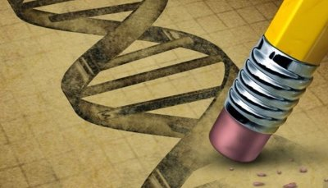
EDITING
HUMANITY
XBBNLDT
SANJANA DURGARAM SINGH

Slide 2
BABIES..?? CUTE OR WEIRD
Notes:
2003 back home.

Slide 3
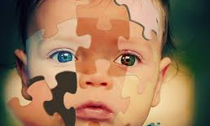
DESIGNER BABIES

Slide 4
THE SECRECT FORMULA
A designer baby is a human embryo that has been genetically modified .
New technology – CRISPR
Clustered regulatory interspaced short
palindromic repeats.

Slide 5
UNBEATABLY BRAINY….
Smarter than average people their age or even older.
Healthier than any of their previous generation.
Immune to any of the diseases. HIV-AIDS , Parkinsons , etc.

Slide 6
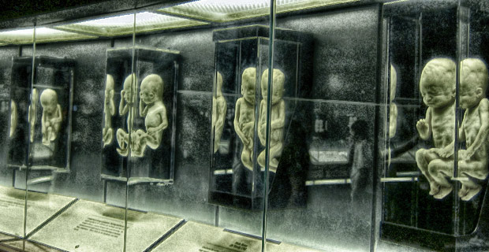
SPOOKY SCI-FI ish ..??

Slide 7
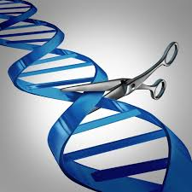
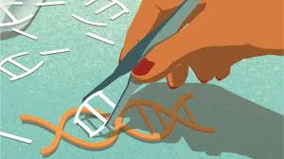
CRISPR

Slide 8
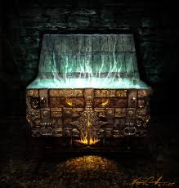
ROLLING DOWN THE FACTS ..!!
Researchers in CHINA have already reported creation of a genetically modified HUMAN EMBRYO.
Unsuccessful and revealed serious obstacles.

Slide 9


Slide 10
LEGALITY ISSUE
USA- legal.
No laws that prohibits the creation of genetically modified humans.
UK- illegal.
It was improvised to permitting the use of GMO to prevent genetic disorders.

Slide 11


Slide 12
The Issue
Characteristics : Aggressiveness and Narcissism
Not every one has a positive goal of experimenting on the GM humans with an aim to reduce the genetic disorders.
Some may do → PROFIT, business, trend.

Slide 13
Extremely healthy → Sicker
GMO can be black marked due to wrong intentional experimentation.
Governments → lowering health care costs.

Slide 14
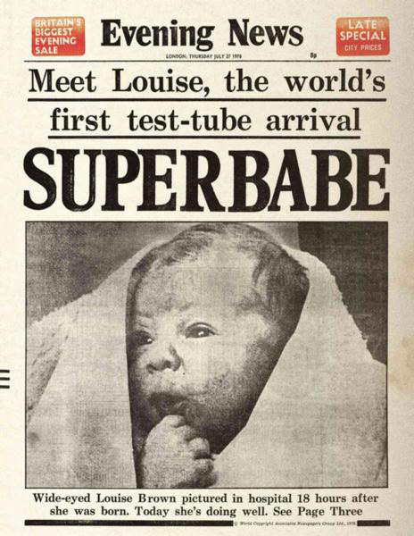
IN-VITRO FERTILIZATION
Louise – first IFV baby ( 3 yrs ago).
1000 + labs delivering innumerous IVF baby

Slide 15
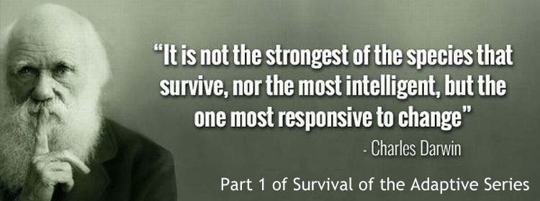

Slide 16
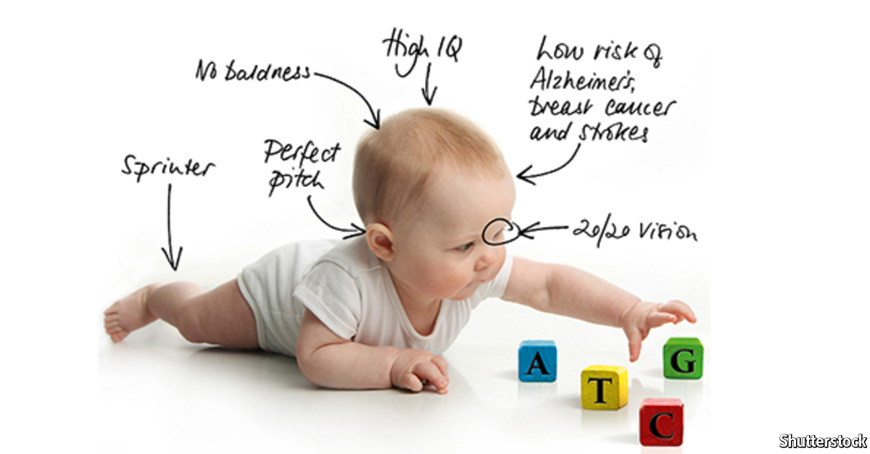

Slide 17
DESIGNER BABIES.. FASHIONABLE ?
Although the idea of creating a progeny of perfectly perfect humans, what the designer babies would deny us would be the ORIGINALITY.
Every baby would be created with a rule book which is not going to produce any uniquely identifiable babies.

Slide 18
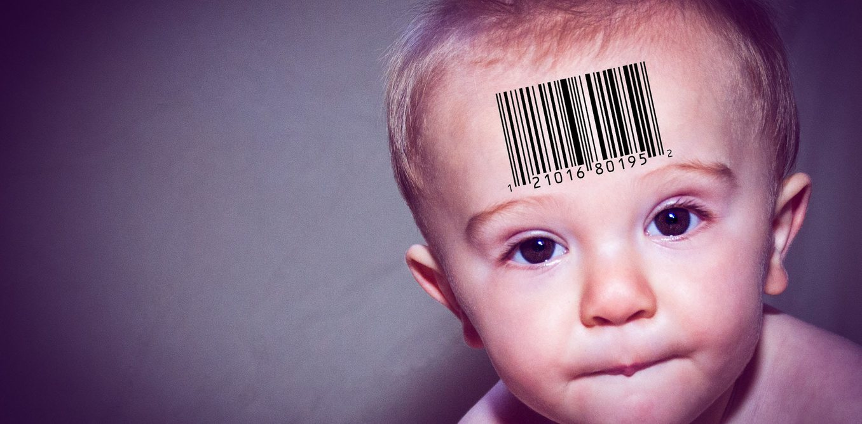
MANUFACTURED

Slide 19
THANK YOU!

